Slide 1



Project Title: EXPENDITURE CALCULATOR
Team Details:
FY- C4 – INFORMATION TECHNOLOGY
- 16010422040 : Suhani Jagtap
- 16010422041 : Parsh Jain
- 16010422050 : Krisha Kapadia

Slide 2
Problem Statement :
People now a days have started using different kind of payment methods . It is difficult to keep records of the same.
So we decided to create a system which would keep track of daily expenses in an well organised manner.
The system can accept the name of user and is able to add, store and view the date , category and amount entered by the users. Hence, making it really easy and quick to find all the expenses made till date at once without having the fear of losing record.

Slide 3
System architecture:
BACK
EXPENSES
DISPLAY WINDOW
DATE
HOME
Submit
NAME
(Expense Tracker)
CATEGORY
(Data stored in json file)
EXPENSE

Slide 4
Features of the system:
The system is user friendly and easy to use.
The program is attractive and visually appealing.
It keeps record of every single date by making the user to enter it (date entry function).
It has a feature of storing expenses with specific category option.
An error window appears for incomplete information.
It calculates the total amount of expense spent by the user up to the current date.

Slide 5
TECHNOLY USED:
Backend python :- Our entire project uses python as a language of medium of communication between the system and the user.
The input is taken from the user and stored in a list in the main function of the project .
The data in the list is then added in the json file where we continuously store data in the entire project.
For the attractive look to our project, we have used tkinter as a gui to make the project have a frontend system and used its designing features for it to look more user friendly.

Slide 6
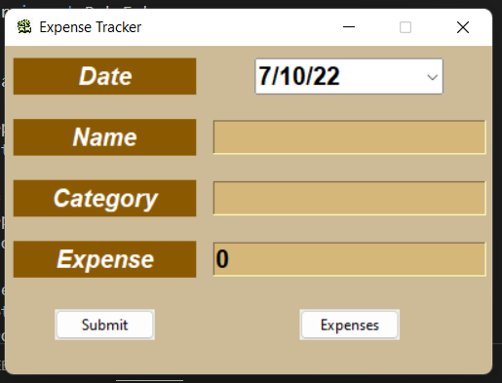
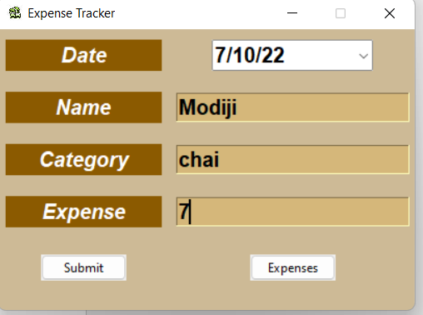
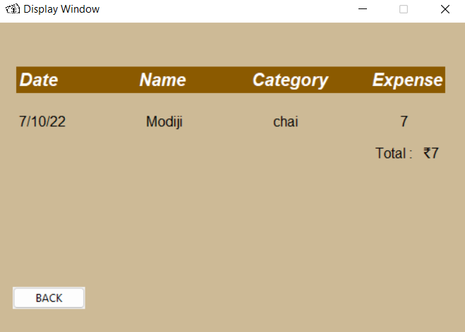
OUTPUT AND RESULTS:
HOME PAGE
INPUT PAGE
DISPLAY PAGE

Slide 7
Result and Conclusion :
We tried to apply our in class developed knowledge about python as language in making a useful project.
We learnt simple frontend using tkinter and data storing in json file.
The project taught us logic building ,team coordination and working as a team .
We also learnt about creating stuff more organised and adding unique features to project to make it more amazing .

Slide 8
References :
Notes of Vaibhav sir
https://www.w3schools.com/js/js_json_intro.asp
https://docs.python.org/3/library/tkinter.html
https://www.w3schools.com/python/python_file_handling.asp
Special thanks to the faculty for teaching and guiding us to make this project happen .

Slide 9
THANK YOU !!

